Slide 1
Innovation Education
Through Robotics and Invention

Slide 2
A Brief Look Back
First Car: Toyota Corona
Malcolm Wells, Wayne Williams & Dr. Kevane
AAPT
South Mountain High School
Physics PLCs in Phoenix Union
Electric Vehicles

Slide 3
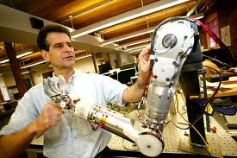
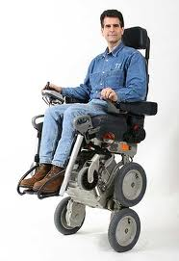

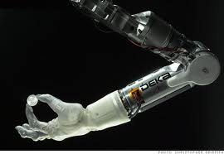
For Inspiration and Recognition of Science & Technology
Dean Kamen: Inventor

Slide 4
Robotics & Physics
How fast should this thing go?
  Motor curves
  Gear ratios
  C=2∏r
What should the game piece manipulator do?
  Pneumatics
  Levers
  Pulley Systems
  Inclined Planes
  Screws

Slide 5
More Robotics & Physics
How do we power it?
  Circuits
  Motor Controllers
  PWM
  Oscilloscope – Waves
  AC/DC
  Fuses
  Wire Gauge
  Solenoids

Slide 6
More Robotics & Physics
How do we make it go?
  Sequencing, Flow Chart, Algorithm
  Logic
  Programming Languages
  Databases
  Sensors
  Input/Output
Computer Aided Design & Animation

Slide 7
Bonus Features
Reading with Intention
Research
Documentation
Report Writing
Presentation
Press Release
Time Management
Tool Safety
Project Management
Fund Raising
Travel
Web Design
Video Editing
Conflict Resolution
Negotiate
Gracious Professionalism
Persistence
Community Service

Slide 8
FRC 2009
Schedule
Video
Production
Web Page
Record
Keeping
Momentos
Game Strategy
Drive Train
Community
Connection
Special
Feature
T-Shirts
Publicity
Electrical
Pneumatics
C A D
(computer aided design)

Slide 9
Lemelson-MIT InvenTeams
Educate to Innovate
More than just a game
Group of diverse students
Passion
Helping others
Monumental task
Data driven decisions
Hard work 11 hrs/week
Parent Support
MIT & Berklee College of Music
Diamonbacks
Time Magazine
Patent Attorney
Phone Call
White House
State of the Union

Slide 10
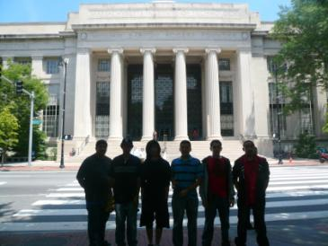
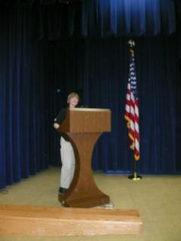
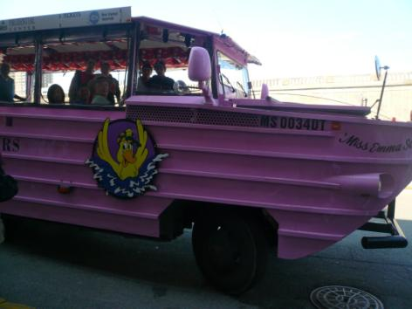
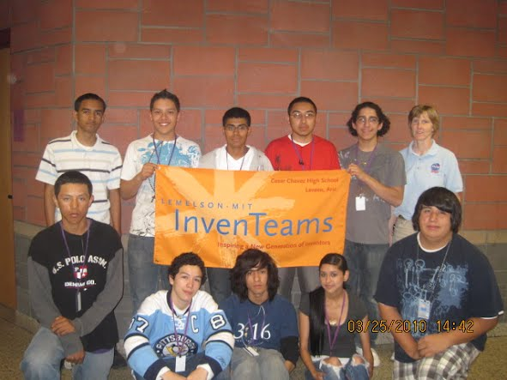
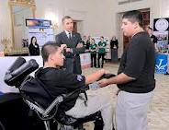

Slide 11
What Now?
Too much work
We need to focus
What to invent
Motivation
Ambiguity
Trust the kids
Going Green
Educating the Future

Slide 12
What can you do?
I’m not sure it matters what you, just do something.
There are lots of different programs & opportunities that I’ll mention in a minute.
But, you don’t have to have it all figured out ahead of time.
In fact, the process and journey are the goal.
When we work with our students as part of the team – figuring it all out with them, we teach them what is really required to be successful as the innovators of tomorrow.

Slide 13


Slide 14
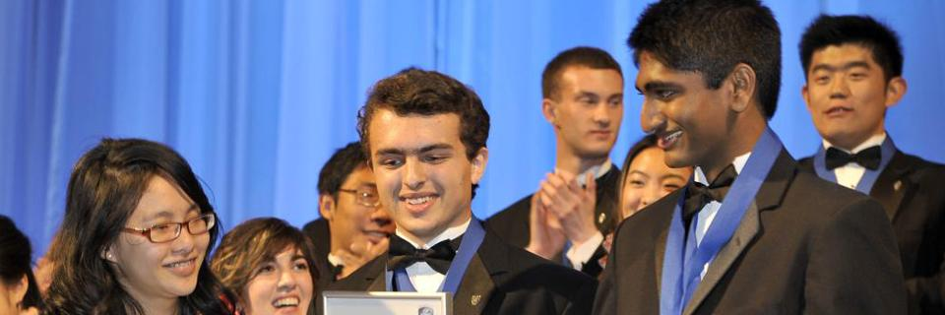
Inspiring Innovators of Tomorrow
Intel Science Talent Search 2012

Slide 15


The Conrad Foundation honors the legacy of Apollo 12 astronaut, Charles "Pete" Conrad, and his three-decade pursuit toward innovation and entrepreneurship. His story is nothing short of inspirational.

Slide 16

Connect a Million
Minds
(Time Warner Cable)

Slide 17


Slide 18


Slide 19


Slide 20


Slide 21


Slide 22


Slide 23


